Slide 1
Difficult Decisions:
Policies vs. Day-to-Day Practices
Carol R. Wright Kenderdine
Assistant Vice-President
Transportation & Mobility
Easterseals, Inc.

Slide 2
Overview
Policies vs. Procedures
Communicating Policies
Why Consistency Matters
Rider Policies
Customer Service
Making Decisions “On the Road”
Reasonable Modification

Slide 3
Policies vs. Procedures
Policy: A stated position on an issue that provides the written basis for rules regulating operations (passed by governing body/Board of Directors).
Procedure: The way we implement our policy – the “how to” instructions for putting the policy into day-to-day practice.

Slide 4
Policies and Procedures
Are the backbone of your agency’s operations
Help determine appropriate actions & reactions
Establish a consistent level of service & treatment of passengers
Support your agency’s vision & mission
Are a reference for decision making
Protect your staff, volunteers & riders

Slide 5
Policies: Important!
Need to be formal
Will be seen by others (internal & external)
May need to support you in legal actions
Depend on the understanding & interpretation of what is written
Mistakes can be costly!

Slide 6
Communicating Policies
Employee Handbook
Bus Driver Manual/Handbook
Rider’s Guide
All Staff Meetings
Bus Driver Meetings
Dispatcher Meetings
Combined Driver/Dispatcher Meetings

Slide 7
Why Consistency Matters
Equal treatment
Staff members
Customers
For defense in case of lawsuits

Slide 8
Setting Rider Policies
How are passenger policies communicated to your riders?
Riders’ Guide
Dispatcher Instructions
Website
Social Media
Driver’s Discretion

Slide 9
Improving Communications
Are there ways you could improve these communications?

Slide 10
Rider Policies That Cause Conflict
Refusal of Service
Door-to-Door vs. Curb-to-Curb
Number of Packages
Assistance with Packages
Fare Payment
Strollers
Food/Beverages Consumed Onboard

Slide 11
Rider Policies
Poor Hygiene
Intoxicated Passengers
Foul Language
Oversized Items
Wait Time for Passenger
Including waiting for passenger to pick up prescription; drop mail at Post Office; get cash at bank or make deposit at ATM; etc.

Slide 12
Policy Scenarios
Scenario # 1
Sarah is an 85-year-old passenger with poor hygiene. She rides your bus to go to her doctor’s appointments and to go grocery shopping. You have received a number of complaints from other passengers. Some drivers want her suspended from riding.
What is your agency’s policy?

Slide 13
Policy Scenarios
Scenario # 2
Mary boards the bus. There are a number of passengers on the bus. She does not have a bus ticket or the fare to pay for her ride. She is a regular passenger. She has mild dementia. This has happened before. How should the driver handle the situation?
What is your agency’s policy?

Slide 14
Policy Scenarios
Scenario #3
A passenger, John, gets on the bus and is very agitated. The passenger does not have money to pay the fare. The driver is not aware of the cause of the situation, but she is reasonably sure that pressing John for the fare or trying to force the customer off of the bus will only cause further disruption or escalate the situation. How should the driver handle the situation? What options does the driver have?
What is your agency’s policy?

Slide 15
Policy Scenarios
Scenario #4
You have a curb-to-curb policy for your demand-response transit system. You have a passenger in a wheelchair who has requested door-through-door assistance as part of an ADA reasonable modification in order for her to use your transit service. A full-time driver, Joe, refuses to honor her request. The passenger states that Betty, another full-time driver provides this service. How do you resolve this conflict?
What is your agency’s policy?

Slide 16
Policy Scenarios
Scenario #5
You have a passenger who frequently rides your bus. Sometimes she has her husband along as her “personal care attendant” who then rides free. Sometimes she rides alone. Your drivers are frustrated because they feel she is “gaming” the system. What do you need to do to resolve the situation?
What is your agency’s policy?

Slide 17
Review and Revise Policies
Recognize indications that it is time for policy review or revision:
More instances of policy violations
Service has changed making policy irrelevant
Increase in complaints from staff and/or passengers
Review policies periodically (annually for ongoing effectiveness)

Slide 18
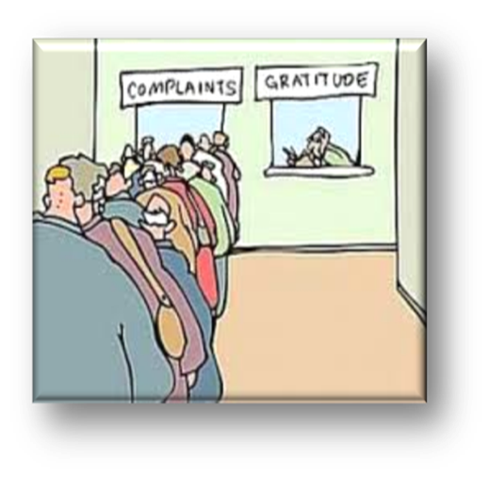
External Feedback
It is not only how the agency sees its policies, but how the customers react to those policies.
Monitor customer (& employee) feedback for patterns.

Slide 19
Policy Work…Never Done!

Slide 20
Customer Service
“We got rid of our customer service department. We got tired of people calling it all the time.”

Slide 21
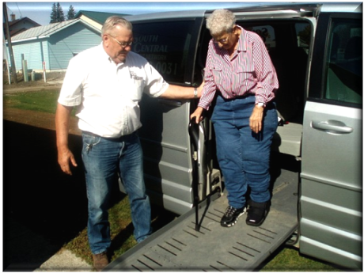
Customer Service “Rules”
You can’t teach a service culture…you have to:
live it.
experience it.
share it.
show it.

Slide 22
Customer Service
Less is almost always MORE!
Nordstrom’s Department Store’s employee handbook reflects their emphasis on exceptional customer service with a total of 75 words.
“Welcome to Nordstrom. We’re glad you are with our company. Our number one goal is to provide outstanding customer service. Set both your personal and professional goals high. We have great confidence in your ability to achieve them.
Please feel free to ask your Department Manager, Store Manager or Human Resource office any questions at any time.”

Slide 23
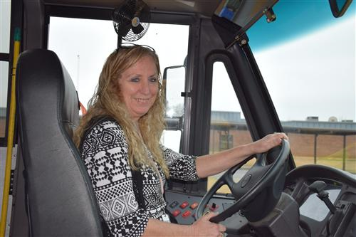
Customer Service
Hire the right people and treat them right.
Southwest Airlines’ Vice President of People is often asked the question, “How do you get your employees to be so nice?” The answer is always the same:
“We hire NICE people!”
When hiring someone, start
with the premise that attitudes
matter most.

Slide 24
Customer Service
Engage your employees
It starts with a compelling VISION…one that focuses on your mission to serve.
Every employee must be able to see how they fit into the big picture. How does their role contribute to the mission and the vision of the agency?
Notes:
When Dr. Martin Luther King, Jr. spoke to 500,000 civil rights marchers in front of the Lincoln Memorial in 1963, he did not exclaim, “I have a strategic plan!” Dr. King, understanding the power of a compelling vision, enthusiastically proclaimed, “I have a dream…”

Slide 25
Customer Service
How do you define your vision?
James River Transit:
MAKING A DIFFERENCE
Too often company mission and/or vision statements are agonized over and then forgotten in a binder on a shelf.
Every employee in the company can figure out how they can make a difference.

Slide 26
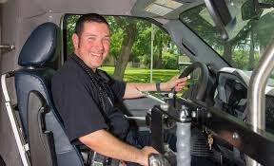
Customer Service
First impressions last
Even if you cannot immediately help someone, at least smile or nod to create a positive first impression.
Greet your customer.
Look like you are happy to see your passengers!
Rule #4

Slide 27
An Inside Job…
Determine if a passenger’s first experience will be favorable or negative.
When you get back to work, pretend you are a new customer.
From the first time you call for a ride…
To the time you stand on the sidewalk as you wait to be picked up…
From stepping up into the bus or being taken up on the lift for the first time…

Slide 28
An Inside Job…
From paying your fare…
To finding your seat…(or having your wheelchair secured)
From the first drop off…
To waiting for your pick-up to return home

Slide 29
First Impressions
What are your first impressions?
Do you know where to wait for the bus?
What do you see?...hear?...smell?...feel?
Is it easy to know how much to pay?...how to pay?
Is it easy to know where to sit?
Do you need to wear a seat belt?
Do you feel comfortable asking questions?
Is there adequate signage to answer questions?
What do the signs say?

Slide 30
First Impressions
If you were to call (please do!), would the person who answers the phone be easy to understand?...be friendly?...be able to speak another language?
Would you have all the information you need before hanging up the phone?
If you seem confused, will things be explained in a way that make it easier for you to understand?...does the person seem frustrated with you?

Slide 31
Repeat Performance!
Reinforce. Reinforce.. Reinforce…
When you have a message you want to deliver to your customers, understand…it won’t happen on its own.
You need to have a plan in place to make it happen and everyone needs to be onboard and agree to do it the same way.
Rule #5

Slide 32
Reinforce…
This may sound simple and like common sense.
To do it right, it is anything but simple.
It takes everyone being on the same page and being consistent.
Everyone needs to be following the same policies and procedures.

Slide 33
It’s the Little Things…
“It’s the little things that make the big things possible. Only close attention to the fine details of any operation makes the operation first class.”
J.W. Marriott

Slide 34
The Happiest Place on Earth…
“Do what you do so well that they will want to come back again and bring their friends!”
Walt Disney

Slide 35
A Crash Course on Customer Service
I apologize for our mistake.
I’m not sure but I will find out.
Please.
Thank you.
I appreciate …
How is it best for me to assist you?
I can take care of that for you.
Have a good rest of your day.

Slide 36
Ask Yourself….?
If customer service were a competitive event, where would you be in the rankings?

Slide 37
Transit Acronyms….HUGS!
Have you H.U.G.G.E.D. a customer lately?
Helped your customer beyond normal expectations?
Understood the nature of the customer’s needs?
Gathered critical information by exploring the customer’s situation?
Given the customer a chance to talk while you listen?
Empathized with the customer’s position if there was a problem or unique circumstance?
Developed a trusting relationship so your customer wants to return?

Slide 38
Viewing from the Outside In: Observe
What do people who ride the bus worry about?
How can you help alleviate their concerns?
What don’t they know about riding the bus?
What do they need to know?
What can we improve to make it better for all?
Do the rules change driver to driver?

Slide 39
(Your transit agency) Believes in HUGGS
Motto:
Help
Us
Give (Great!)
Service!

Slide 40
Customer Service vs. Policies & Procedures
What does customer service have to do with Policies and Procedures?
EVERYTHING!
You are responsible for knowing the Policies and implementing them consistently across the entire agency. What one does for the customer…everyone does because everyone follows the same procedures!

Slide 41
Areas Where Conflicts Tend to Occur
The number one area where policies and procedures tend to collide, and drivers tend to disagree on the proper way to respond is in the area of:
ADA REASONABLE MODIFICATION

Slide 42
Reasonable Modification
Transit systems must modify their policies to accommodate the needs of people with disabilities unless the modified policies would result in:
an undue burden or a fundamental alteration of the transit program, service or activity
a direct threat to the health or safety of others
without the requested modification, the individual with a disability is still able to fully use the entity’s services, programs or activities for their intended purpose

Slide 43
Additional Requirements
Information about the reasonable modification process and how to use it must be available to the public.
The request process must be accessible.
The process must provide for situations in which making an advanced request is not feasible
Allowing bus drivers to make a determination
Being able to contact supervisors for assistance and an on-the-spot decision
Customers do not have to use the words “reasonable modification” when making their request.

Slide 44
Do I Have to Do THAT?????

Slide 45
ADA Reasonable Modification
This leads to drivers sometimes making different decisions depending on the driver.
Some drivers think they are adhering directly to the agency’s policies.
Some believe they are using their discretion to provide better customer service.
Some believe they are doing what the ADA says they must.

Slide 46
Consistency & Education
This is why everyone at the agency needs to:
be educated about Reasonable Modification
know what to do if they are unsure of how to handle a customer’s special request
have dispatchers and drivers relay the same messages to customers
discuss concerns with management

Slide 47
Examples: Reasonable Modification

Slide 48
Question
If the transit system provides curb-to-curb service, do they have to provide assistance to and from the door for a person with disabilities if needed?

Slide 49
Answer
Yes. This would be considered a reasonable modification to the agency policy (unless doing so is a risk to safety of equipment and passengers). Agency must be able to satisfactorily establish the risk is great enough that they could not offer the assistance.
The driver is never responsible for door-through-door service, unless this is a specific service offered by the agency.

Slide 50
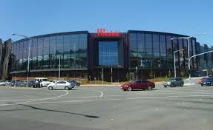
Question
The transit agency’s policy is that all passengers going to the mall be picked up and dropped off at the mall’s main entrance. Should the agency consider a modification to this policy for a passenger with a disability if the person needs the modification in order to take the service?

Slide 51
Answer
Yes. This would be considered a reasonable modification to the policy.
NOTE: Agencies can enforce safety considerations when making modification decisions (i.e., the drop off location is accessible for the vehicle and the passenger can safely disembark).

Slide 52
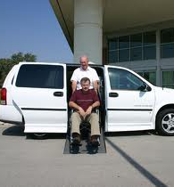
Question
The transit agency’s policy is that passengers cannot request special vehicles or particular seats on vehicles. Should the agency consider a modification to this policy if a person with a disability needs the modification to take the service?

Slide 53
Answer
It depends. If the person is in an oversized wheelchair that only fits on certain agency vehicles, the answer would be yes. If it is strictly for personal preference or because they like a particular driver better, the answer is no.
A passenger’s request for a certain seat in a vehicle does not have to be granted. However, if the person tends to become nauseated when seated in the rear of the bus, they can make the driver aware and if it is possible, the driver can arrange for them to sit closer to the front. This would be determined on a case-by-case basis on the day of the trip.

Slide 54
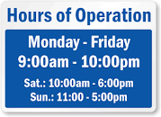
Question
Would it be considered a reasonable modification if a person with a disability requested service outside of the transit system’s service area or not within the existing hours of service provided?

Slide 55
Answer
No.
A person’s request for service outside of the transit agency’s service area or existing hours of operation would not be considered a reasonable modification. It would be a fundamental alteration of the entity’s service.

Slide 56
Question: Intermediate Stops
If a passenger with a disability arranges to be picked up at a medical facility and dropped off at home, but on the way back, requests that the driver park outside of the pharmacy and wait for the passenger to return and then continue the ride home, would this be considered a reasonable modification?

Slide 57
Answer: Well, maybe…
The FTA views granting a request for an intermediate stop, where the driver would be required to wait, as optional.
While this is a very useful service to the passenger, and may ultimately save the agency time as well, such a stop in the context of public transit (which is a shared ride system) is not required. Requests that could disrupt schedules and inconvenience other passengers could rise to the level of a fundamental alteration of service.
However, if at the time of the request, it is feasible to do so, it would be fine to accommodate the request.

Slide 58
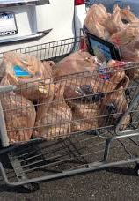
Question: True or False?
The agency has a policy that passengers can only have the number of packages that they can handle themselves.
A request for the bus driver to assist a person with a disability with packages or luggage should generally be granted if the weight of the luggage and/or the number of packages is considered reasonable.

Slide 59
Answer
False. A request for operators to assist with packages or luggage may be denied if:
Policy exists that states drivers will not assist
It is a fundamental alteration of service
It is considered to be a service provided by a personal care attendant (PCA).
(continued on next slide)

Slide 60
Reasonable Modification: Packages, continued
However, if the request is made in advance, the number of packages is indeed reasonable (not the number shown in the picture), and the driver is able to assist, it may be a service you are reasonably willing to provide for a person with a disability who does not have a PCA to assist them.
You never take the packages across a threshold into an apartment or house, unless this is a specific service offered by your agency. You may set them across a threshold without entering the building or residence.

Slide 61
KEY
Having all dispatchers and drivers trained to proficiency on the ADA rules and regulations as well as what is expected of the agency regarding reasonable modification.
When everyone is well-trained, they can be confident in the decisions that they make – especially those that need to be made spontaneously.

Slide 62
RESOURCES
Check out the FTA web site with information on ADA such as requirements and best practices for vehicle maintenance, stop announcements, eligibility requirements, telephone “hold time” issues, origin to destination policies, on-time performance, and dealing with no-shows.
http://www.fta.dot.gov/civilrights/12325.html
49 CFR Appendix E to Part 37 – Reasonable Modification Requests

Slide 63
RESOURCES
The Disability Rights Education & Defense Fund (DREDF) funded by FTA and the U.S.DOT brought together the requirements of the ADA regulations, FTA determinations, and operational practices that comply with the ADA in their “Topic Guides on ADA Transportation.”
http://dredf.org/transportation

Slide 64
RESOURCES
Easterseals Project ACTION Consulting website offers information on various topics relating to the ADA and accessible transportation.
http://www.projectaction.com

Slide 65
RESOURCES
The National Aging and Disability
Transportation Center (NADTC)
is funded by the Federal Transit Administration
to serve as a technical assistance center
regarding accessible transportation for older adults and people with disabilities and to support information regarding the ADA.
www.nadtc.org

Slide 66
Questions?

Slide 67
Contact Information
Carol R. Wright Kenderdine
Co-Director, National Aging & Disability Transportation Center
Assistant Vice President, Easterseals
cwright@easterseals.com

Slide 68
866-983-3222
www.nadtc.org

Slide 69
NADTC and Easterseals say…

